Slide 1
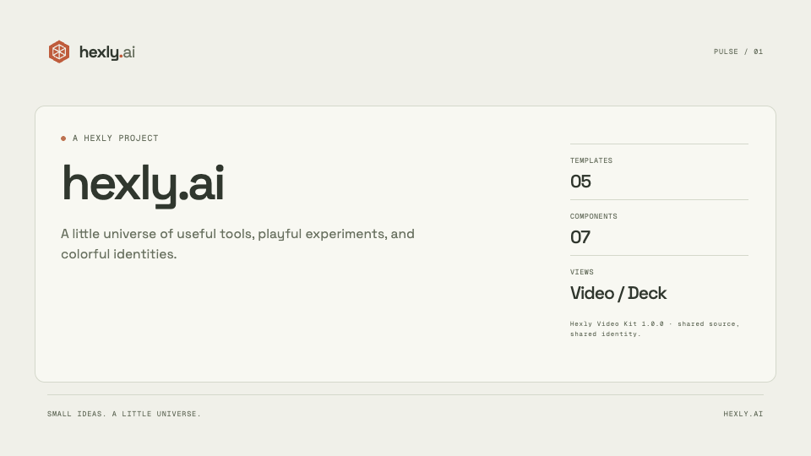
Notes:
A HEXLY PROJECT
hexly.ai
A little universe of useful tools, playful experiments, and colorful identities.
Hexly Video Kit 1.0.0 · shared source, shared identity.
https://github.com/nocoo/hexly.ai

Slide 2
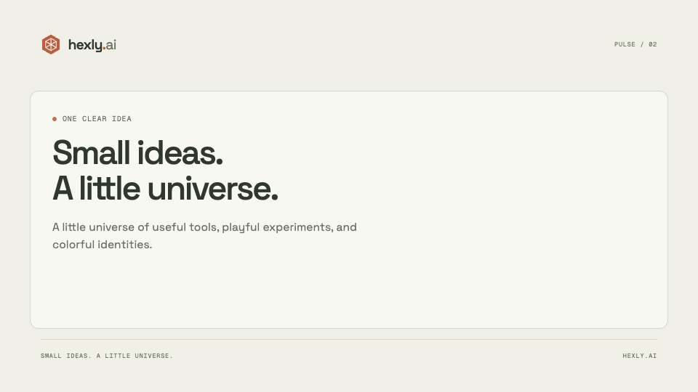
Notes:
ONE CLEAR IDEA
Small ideas.
A little universe.
A little universe of useful tools, playful experiments, and colorful identities.
Hexly Video Kit 1.0.0 · shared source, shared identity.
https://github.com/nocoo/hexly.ai

Slide 3

Notes:
01 / INSIDE THE PROJECT
From idea
to detail.
A closer look at hexly.ai.
Hexly Video Kit 1.0.0 · shared source, shared identity.
https://github.com/nocoo/hexly.ai

Slide 4
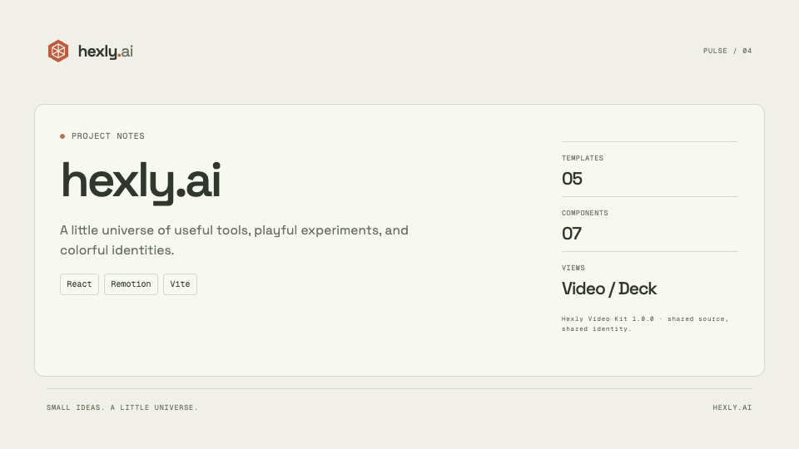
Notes:
PROJECT NOTES
hexly.ai
A little universe of useful tools, playful experiments, and colorful identities.
Hexly Video Kit 1.0.0 · shared source, shared identity.
https://github.com/nocoo/hexly.ai

Slide 5

Notes:
TAKE A CLOSER LOOK
Make room
for the idea.
https://hexly.ai
Hexly Video Kit 1.0.0 · shared source, shared identity.
https://github.com/nocoo/hexly.ai

Slide 6

Notes:
HEXLY
Space for good work.
Hexly Video Kit 1.0.0 · shared source, shared identity.
https://github.com/nocoo/hexly.ai

Slide 7

Notes:
HEXLY
hexly.ai
hexly.ai
Hexly Video Kit 1.0.0 · shared source, shared identity.
https://github.com/nocoo/hexly.ai

